Slide 1
Memory Management
Type of Questions which can be made

Slide 2
PYQ
https://practicepaper.in/gate-cse/memory-management

Slide 3

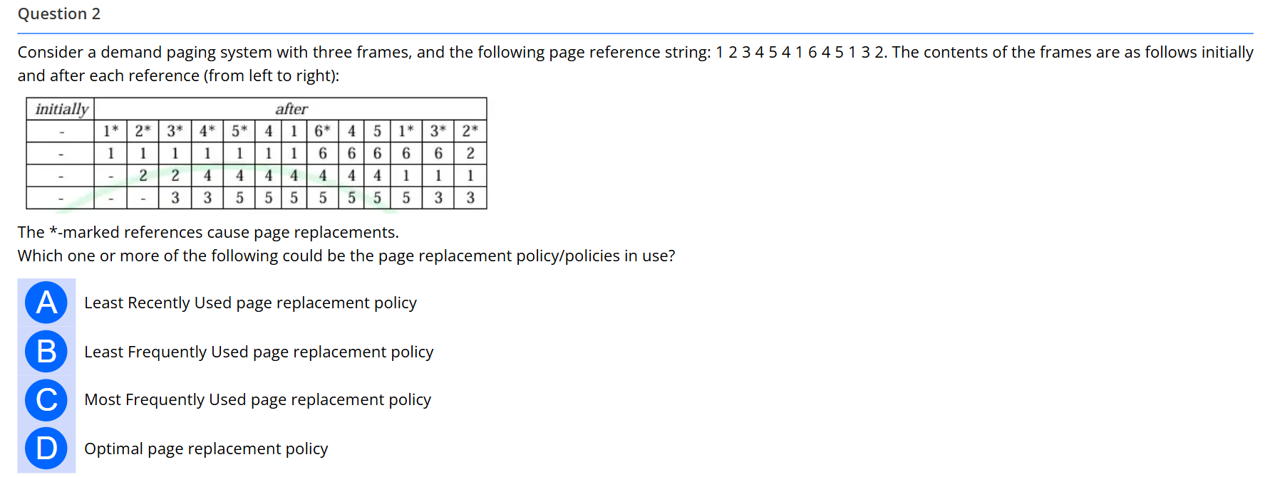

Slide 4



Slide 5




Slide 6



Slide 7




Slide 8




Slide 9

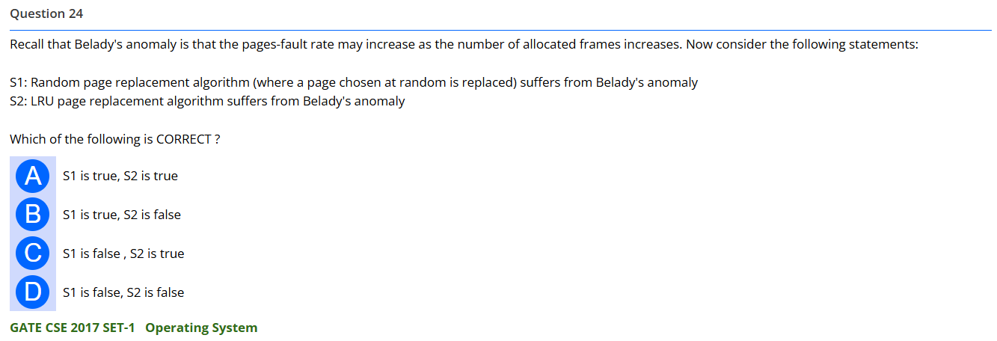

Slide 10
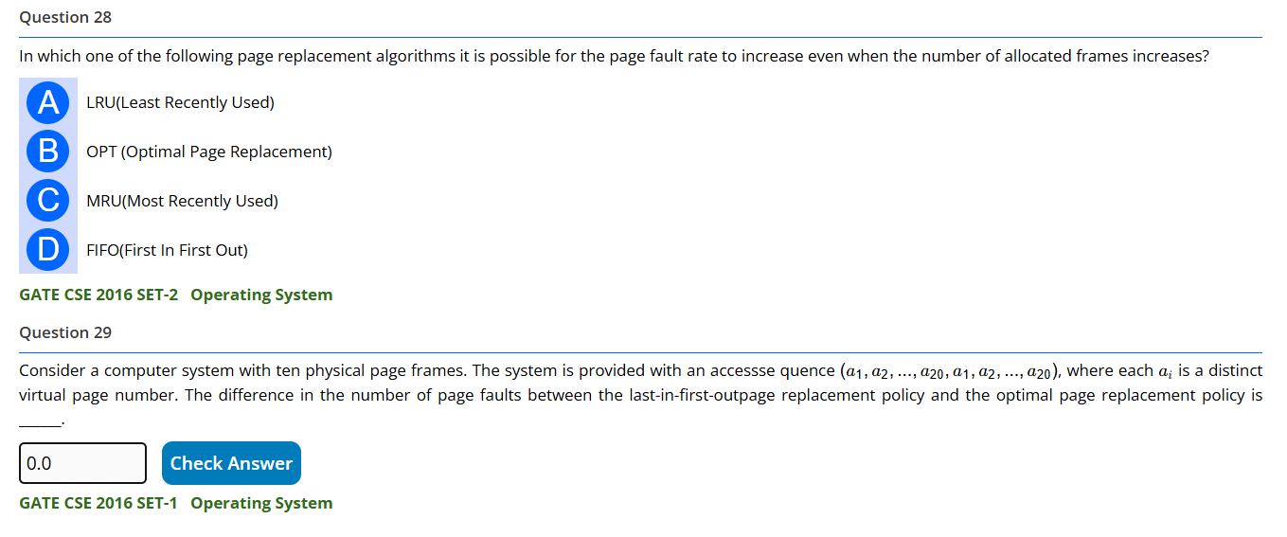



Slide 11

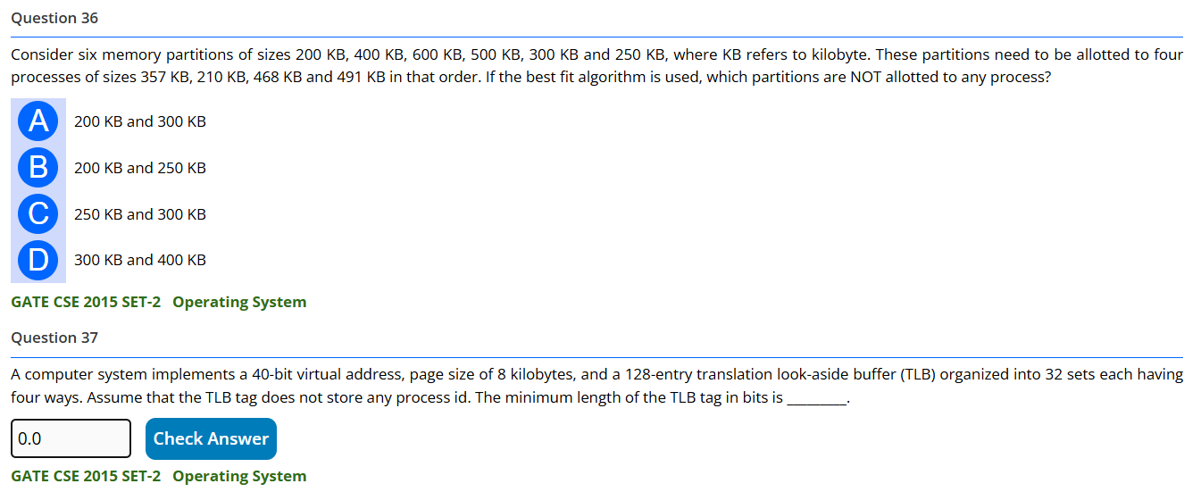

Slide 12
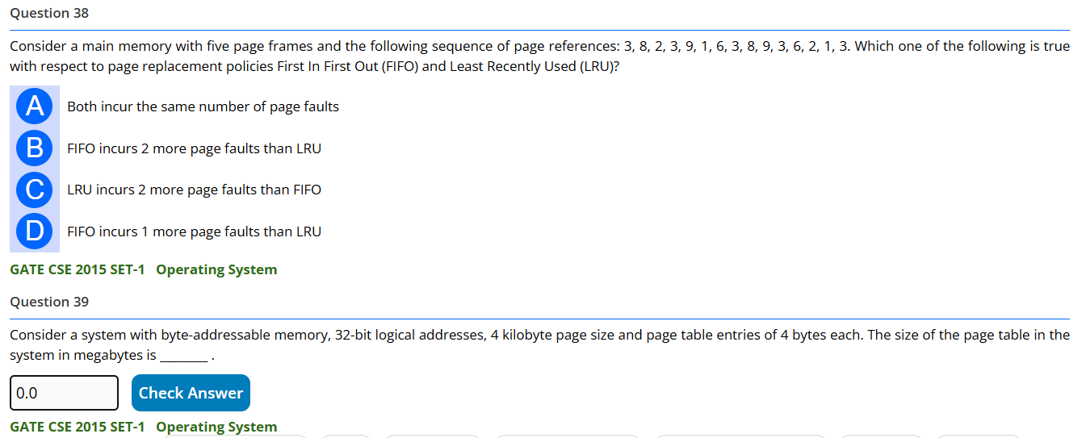

Slide 13
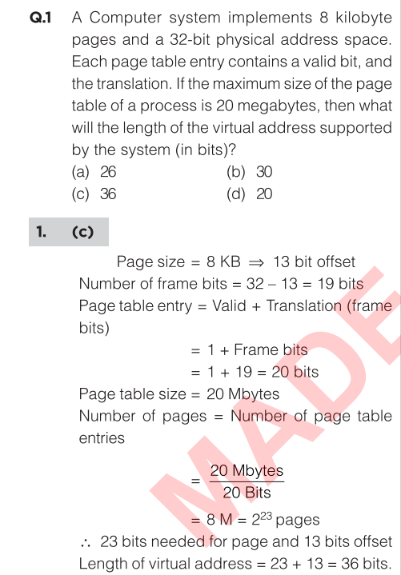
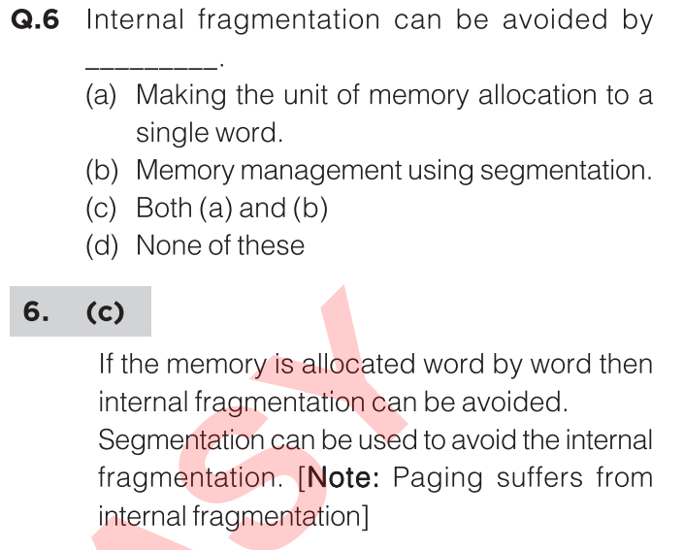

Slide 14
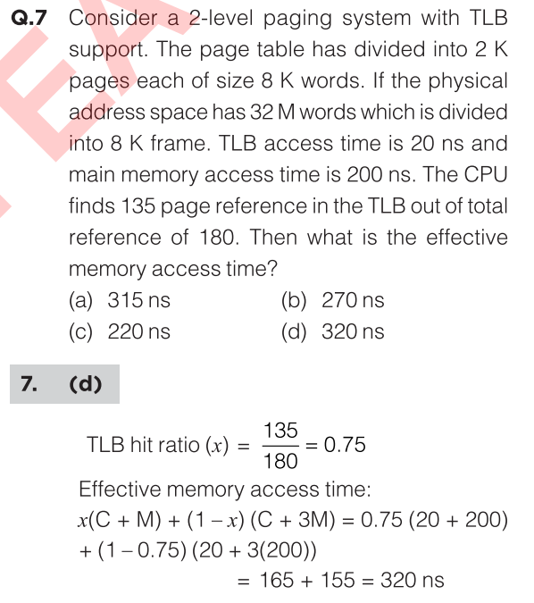

On a TLB miss (two-level page table): you must read two page-table levels from memory (2 × 200 ns) then read the data from memory (200 ns)

Slide 16
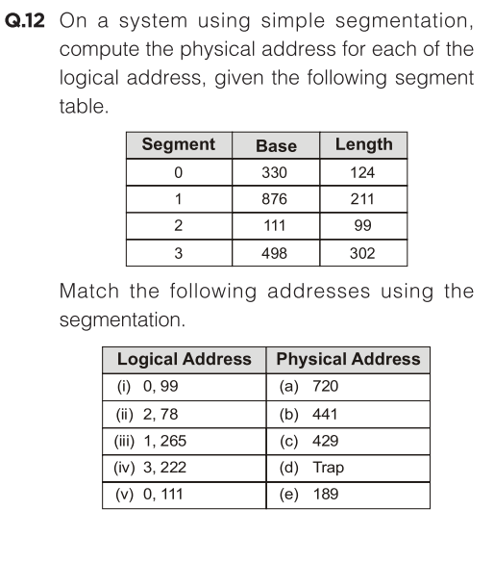
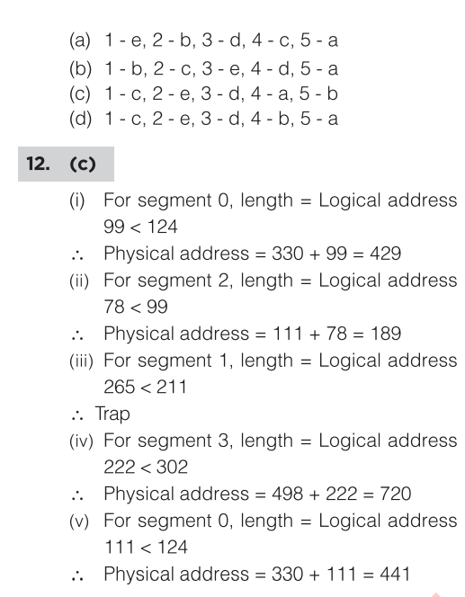

Slide 17
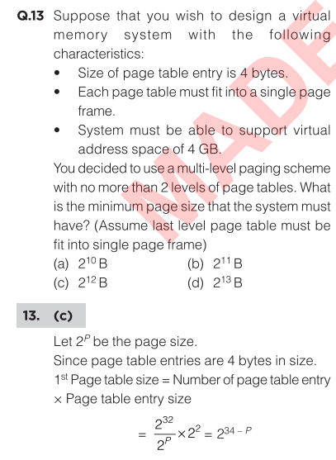
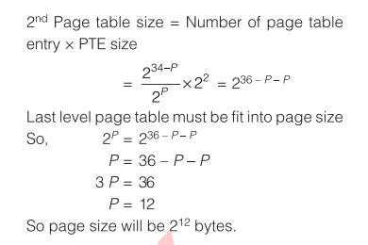

Slide 18
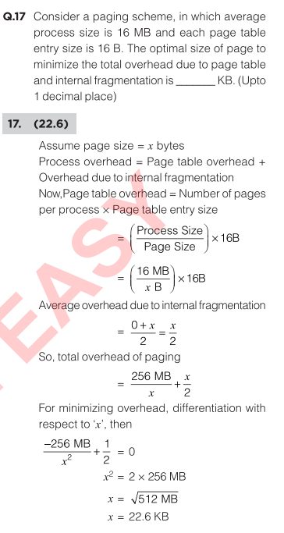

Slide 19


Theory

